Slide 1


Slide 2
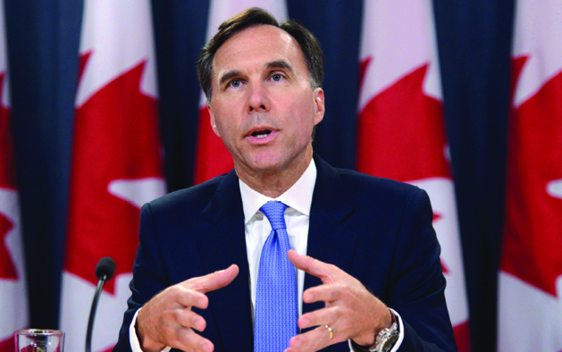
13
FISCAL POLICY
Notes:
Notes and teaching tips: 7, 9,13, 17, 22, 34, 39, 41, and 46.
To view a full-screen figure during a class, click the expand button.
To return to the previous slide, click the shrink button.
To advance to the next slide, click anywhere on the full screen figure.
Applying the principles of economics to interpret and understand the news is a major goal of the principles course. You can encourage your students in this activity by using the two features: Economics in the News and Economics in Action.
(1) Before each class, scan the news and select two or three headlines that are relevant to your session today. There is always something that works. Read the headline and ask for comments, interpretation, discussion. Pose questions arising from it that motivate today’s class. At the end of the class, return to the questions and answer them with the tools you’ve been explaining.
(2) Once or twice a semester, set an assignment, for credit, with the following instructions:
(a) Find a news article about an economic topic that you find interesting.
(b) Make a short bullet-list summary of the article.
(c) Write and illustrate with appropriate graphs an economic analysis of the key points in the article.
Use the Economics in the News features in your textbook as models.

Slide 3
After studying this chapter, you will be able to:
Describe the federal budget process and the recent history of outlays, revenues, deficits, and debt
Explain the supply-side effects of fiscal policy
Explain how fiscal stimulus is used to fight a recession
Copyright © 2019 Pearson Canada Inc.

Slide 4
The Federal Budget
The federal budget is the annual statement of the federal government’s outlays and revenues.
The federal budget has two purposes:
1. To finance the activities of the federal government
2. To achieve macroeconomic objectives
Fiscal policy is the use of the federal budget to achieve macroeconomic objectives, such as full employment, sustained economic growth, and price level stability.

Slide 5
The Federal Budget
Budget Making
The federal government and Parliament make fiscal policy.
After a long, draw-out process of consultations, the Minister of Finance presents a budget plan to Parliament.
Parliament debates the plan and enacts the laws necessary to implement it.

Slide 6
The Federal Budget
Highlights of the 2019 Budget
The 2019 federal budget has revenues of $278 billion, outlays of $296 billion, and a deficit of $18 billion.
Revenues come from personal income taxes, corporate income taxes, indirect taxes, and investment income.
Personal income taxes are the largest revenue source.
Outlays are transfer payments, expenditure on goods and services, and debt interest.
Transfer payments are the largest item of outlays.

Slide 7
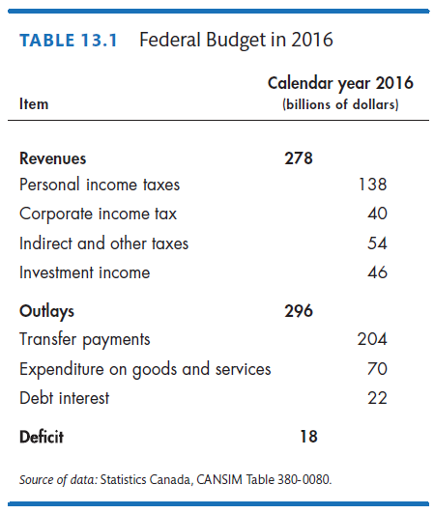
Notes:
Classroom activity
Check out Economics in Action: Provincial and Local Governments

Slide 8
The Federal Budget
Budget Balance
The federal government’s budget balance equals revenues minus outlays.
If revenues exceed outlays, the government has a budget surplus.
If outlays exceed revenues, the government has a budget deficit.
If revenues equal outlays, the government has a balanced budget.
The projected budget deficit in 2013 is $14 billion.

Slide 9
The Federal Budget
The Budget in Historical Perspective
Figure 13.1 shows the government’s revenues, outlays, and budget balance for the period 1960 to 2016.
During the 1960s, outlays and revenues increased.
During the late 1970s and through the 1980s, outlays continued to rise but revenues fell and then remained steady. A large budget deficit arose.
During the 1990s, expenditure cuts eliminated the budget deficit, and after 1997, the budget returned to surplus.
A deficit re-emerged during the 2008–2009 recession.
Notes:
Classroom activity
Check out Economics in Action: The Canadian Budget in Global Perspective

Slide 10
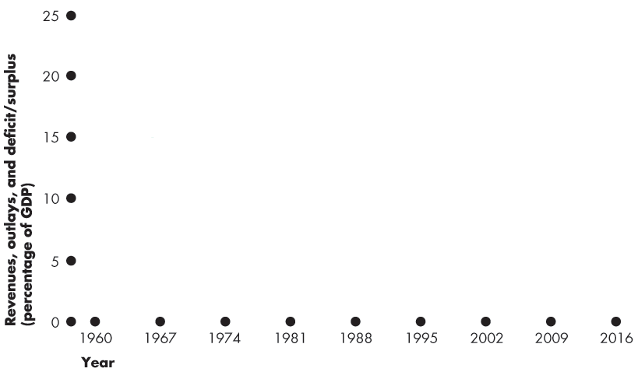
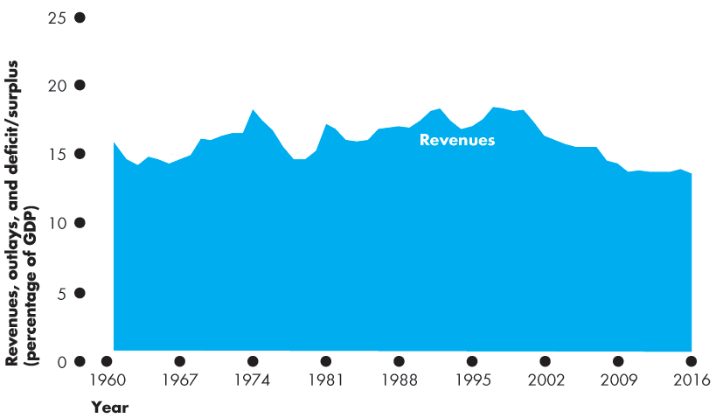
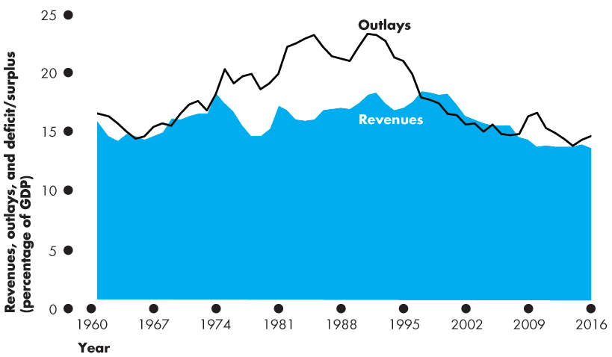
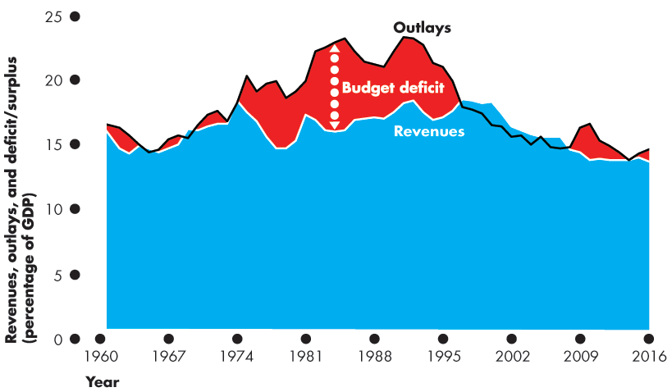

The Federal Budget
Budget Balance

Slide 11
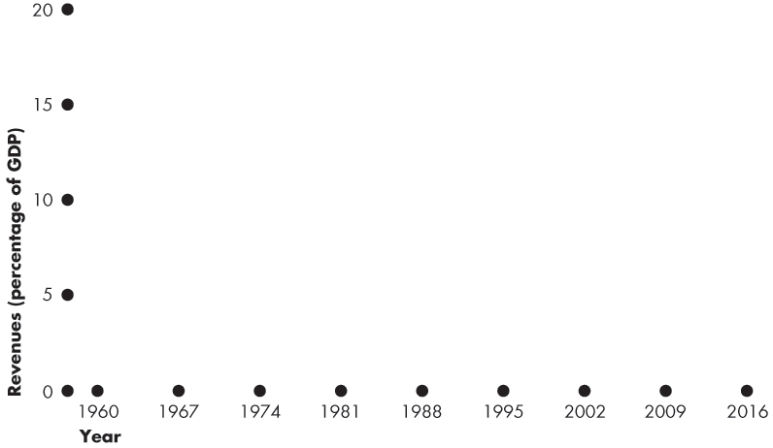
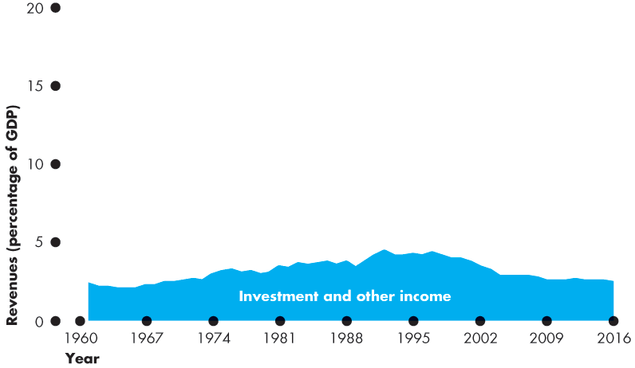
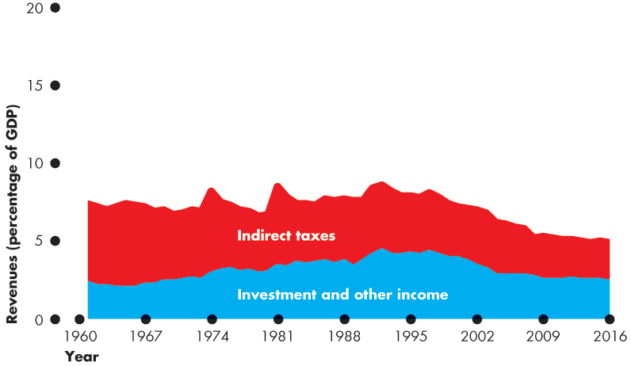
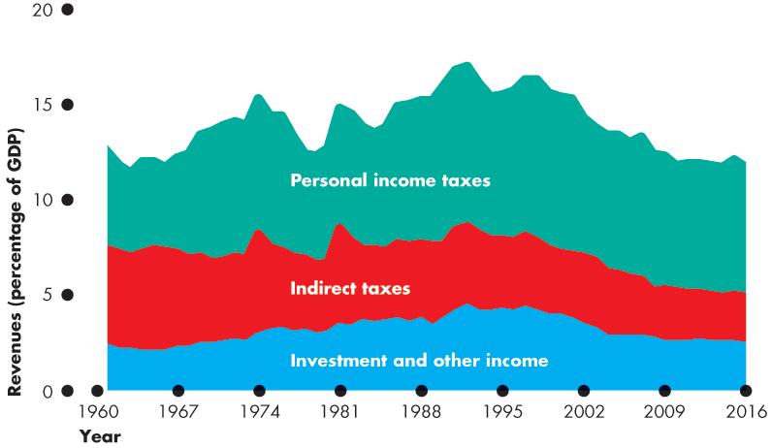
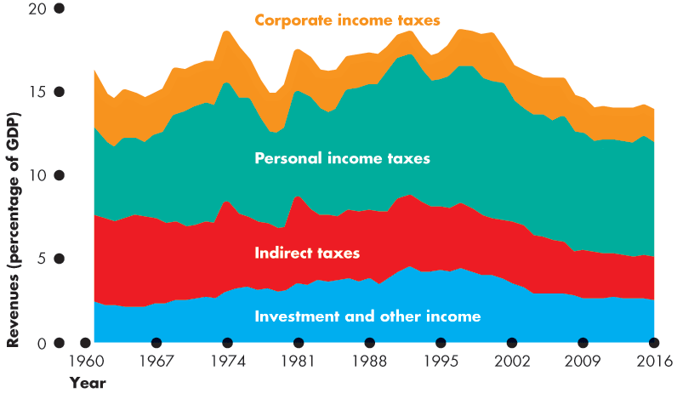
The Federal Budget
Revenues
Figure 13.2 shows revenues as a percentage of GDP.

Slide 12
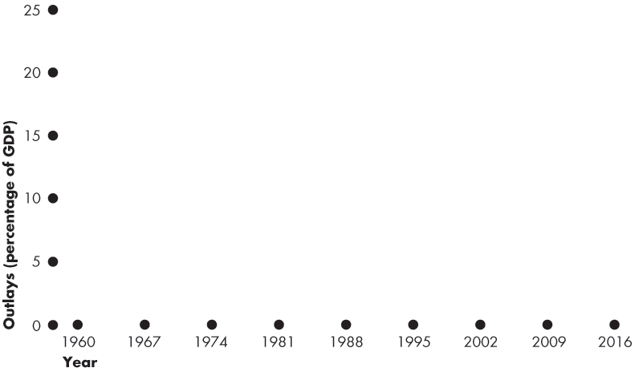
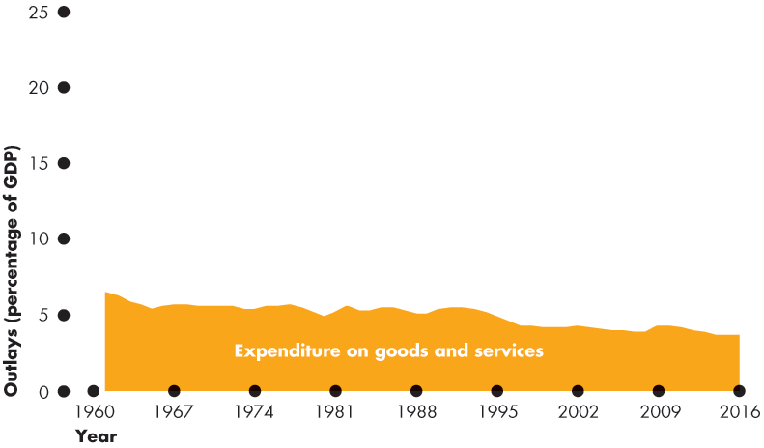
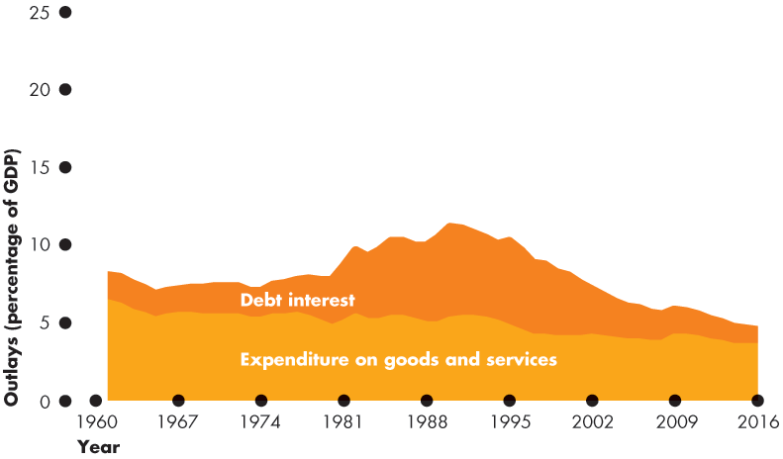
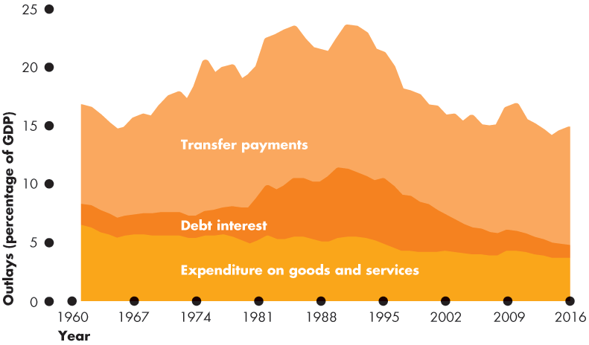
The Federal Budget
Outlays
Figure 13.3 shows outlays as a percentage of GDP.

Slide 13
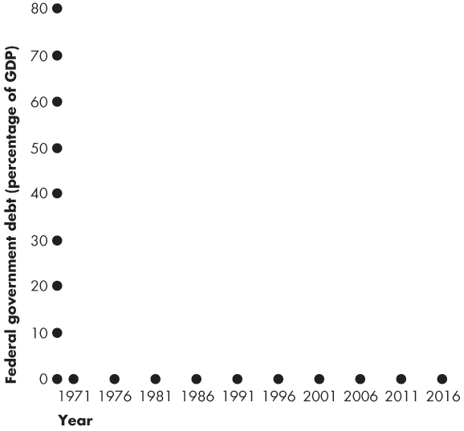
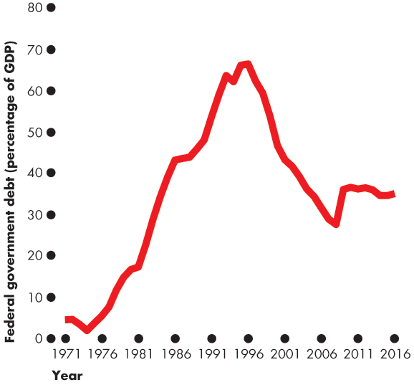
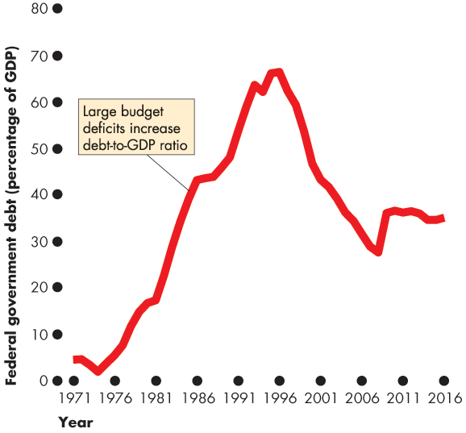
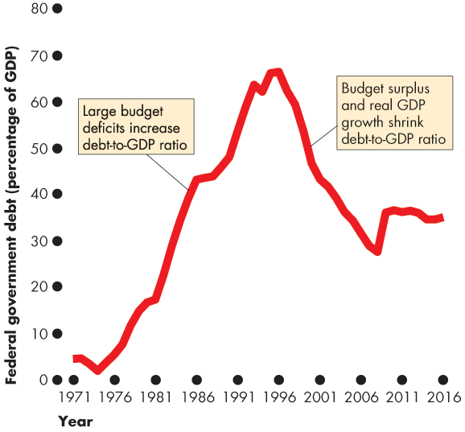

The Federal Budget
Deficit and Debt
Government debt is the total amount that the government borrowing.
It is the sum of past deficits minus past surpluses.
Figure 13.4 shows the federal government’s debt as a percentage of GDP.
Notes:
Deficit and debt. Many students need help with the distinction between the deficit and the debt (and with what happens to the debt when there is a surplus). Use the student loan or credit card analogy. Explain that the budget balance—the deficit or surplus—is just like a personal budget balance—the amount that a student borrows or pays back during a given year. The debt—the amount owed by the government—is like the balance on a student loan or credit card account. Students (usually) have a budget deficit and increasing debt. And graduates with a job (usually) have a budget surplus and decreasing debt.
Does the debt matter? You can have endless fun debating this question. If you do engage your students in this question, you will want to point them to thinking about:
1. The distinction between domestically held debt and foreign held debt.
2. No matter how much the government owes every single year, Y = C + I + G + X – M, so the resources available depend on productive capacity, not on paper claims.

Slide 15
The Federal Budget
Debt and Capital
Debt enables the holder to buy assets that will earn a return that exceeds the interest paid on the debt.
Some government expenditure is investment—the purchase of public capital (highways, universities, national defence, etc.) that yields a social return that probably far exceeds the interest rate the government pays on its debt.
But Canadian government debt, which is $709 billion, is much larger than the value of the public capital stock.
This fact means that some government debt has been incurred to finance public consumption expenditure.

Slide 16
The Supply-Side Effects of Fiscal Policy
Fiscal policy has important effects on employment, potential GDP, and aggregate supply—called supply-side effects.
Full Employment and Potential GDP
Income taxes change full employment and potential GDP.

Slide 17
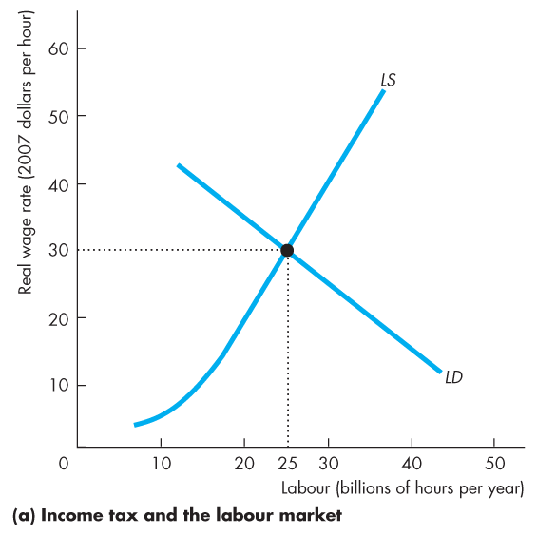
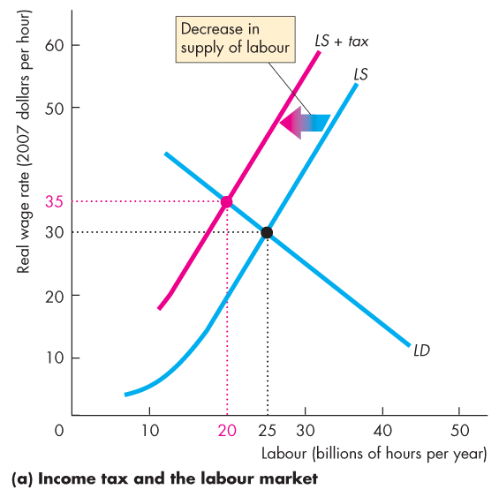
The Supply-Side Effects of Fiscal Policy
Figure 13.5(a) illustrates the effects of an income tax in the labour market.
The supply of labour decreases because the tax lowers the after-tax real wage rate.
Notes:
This section builds on the micro chapters that discuss the effects of taxes. If your students have not yet done a micro course and you want to cover this material, you’ll need to take it slowly and carefully.

Slide 18
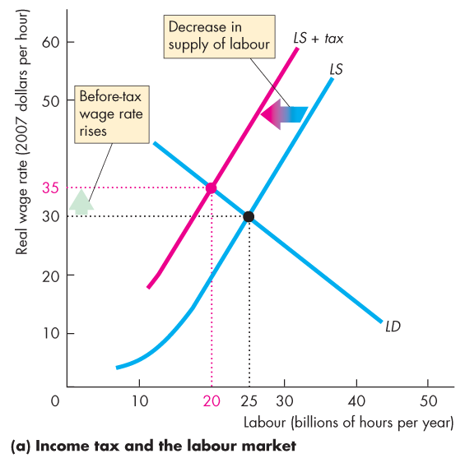
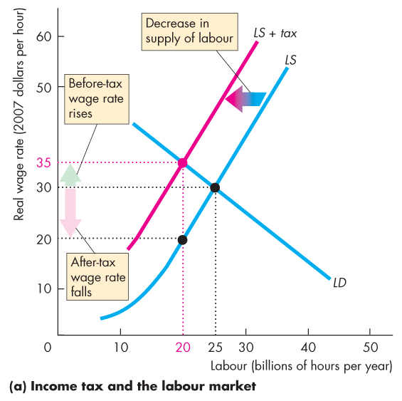
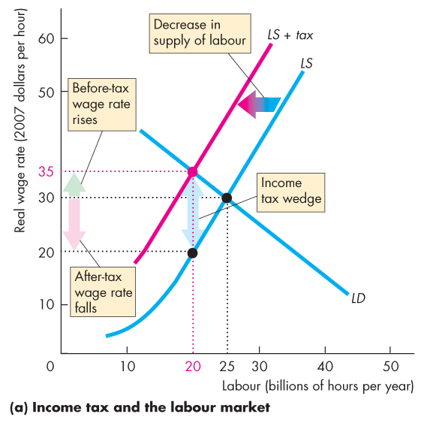
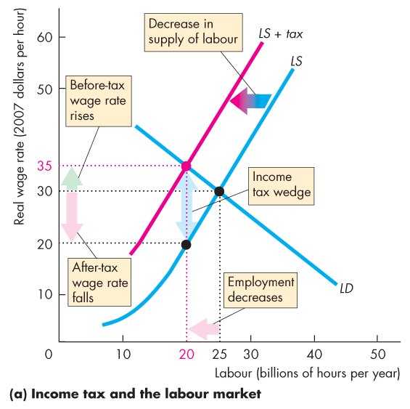

Slide 19
The Supply-Side Effects of Fiscal Policy
The before-tax real wage rate rises, but the after-tax real wage rate falls.
The gap created between the before-tax and after-tax wage rates is called the tax wedge.
The quantity of labour employed decreases.

Slide 20
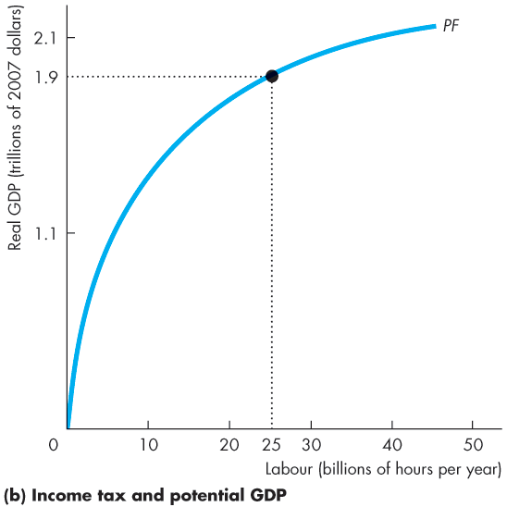
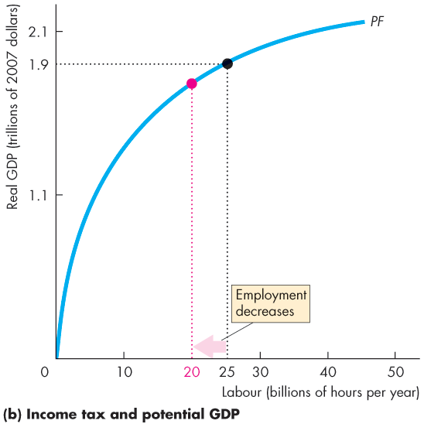
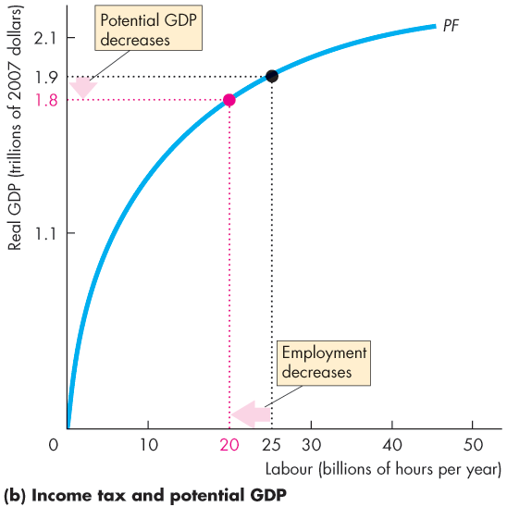
The Supply-Side Effects of Fiscal Policy
When the quantity of labour employed decreases, potential GDP decreases.
The supply-side effect of a rise in the income tax decreases potential GDP and decreases aggregate supply.

Slide 22
The Supply-Side Effects of Fiscal Policy
Taxes on Expenditure and the Tax Wedge
Taxes on consumption expenditure add to the tax wedge.
The reason is that a tax on consumption raises the prices paid for consumption goods and services and is equivalent to a cut in the real wage rate.
If the income tax rate is 25 percent and the tax rate on consumption expenditure is 10 percent, a dollar earned buys only 65 cents worth of goods and services.
The tax wedge is 35 percent.
Notes:
Classroom activity
Check out Economics in Action: Some Real-World Tax Wedges

Slide 23
The Supply-Side Effects of Fiscal Policy
Taxes and the Incentive to Save and Invest
A tax on capital income lowers the quantity of saving and investment and slows the growth rate of real GDP.
The interest rate that influence saving and investment is the real after-tax interest rate.
The real after-tax interest rate subtracts the income tax paid on interest income from the real interest.
Taxes depend on the nominal interest rate. So the true tax on interest income depends on the inflation rate.

Slide 24
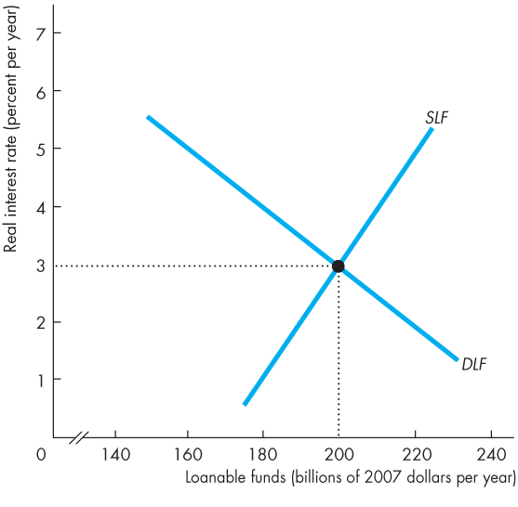
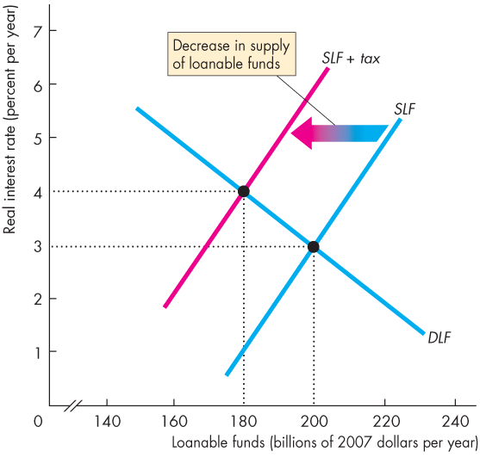
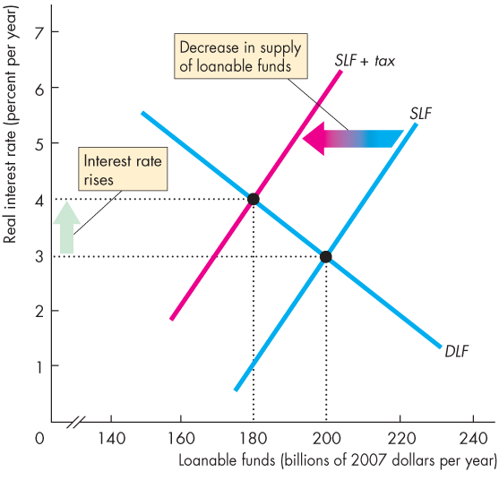
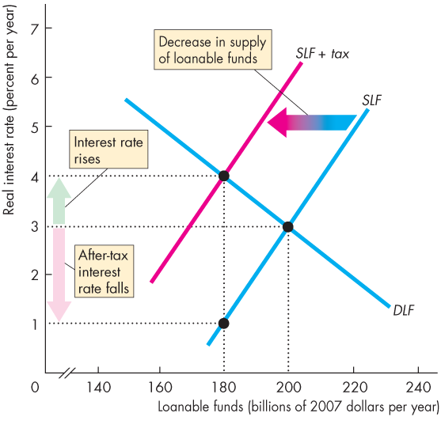
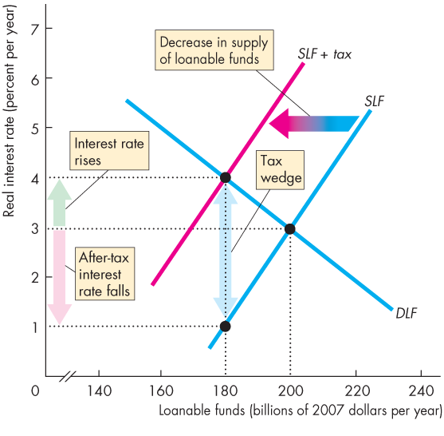
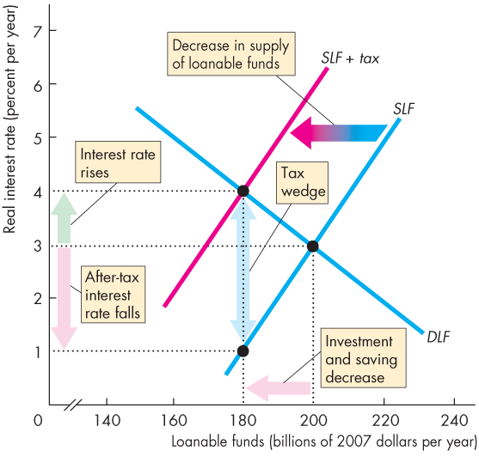
The Supply-Side Effects of Fiscal Policy
Figure 13.6 illustrates the effects of a tax on capital income.
A tax decreases the supply of loanable funds …
a tax wedge is driven between the real interest rate and the real after-tax interest rate.
Investment and saving decrease.

Slide 26
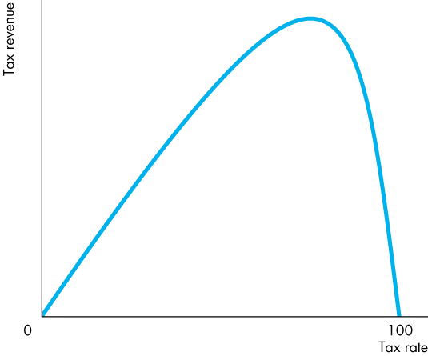
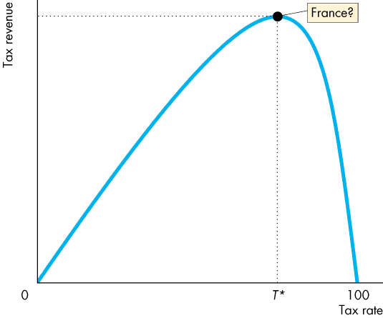
The Supply-Side Effects of Fiscal Policy
Tax Revenues and the Laffer Curve
The relationship between the tax rate and the amount of tax revenue collected is called the Laffer curve.
At the tax rate T*, tax revenue is maximized.

Slide 27
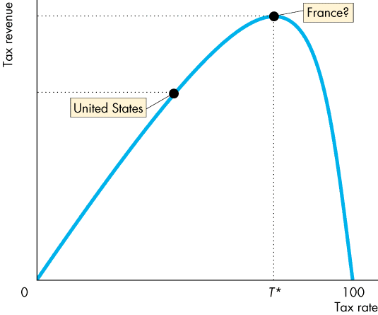
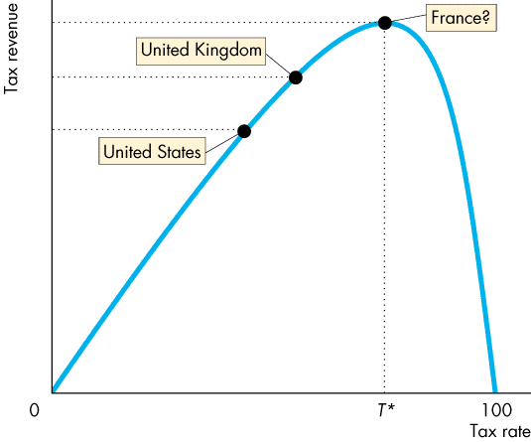
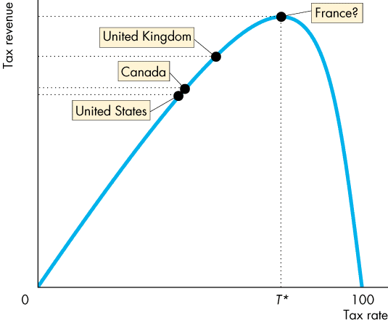

Slide 28
The Supply-Side Effects of Fiscal Policy
If the current tax rate is less than T*, then a rise in the tax rate will increase tax revenue.
If the current tax rate exceeds T*, then a rise in the tax rate will decrease tax revenue.

Slide 29
Fiscal Stimulus
A fiscal stimulus is the use of fiscal policy to increase production and employment.
Fiscal stimulus can be either
Automatic or
Discretionary.
Automatic fiscal policy is a fiscal policy action triggered by the state of the economy with no government action.
Discretionary fiscal policy is a policy action that is initiated by an act of Parliament.

Slide 30
Fiscal Stimulus
Automatic Fiscal Policy and Cyclical and Structural Budget Balances
Two items in the government budget change automatically in response to the state of the economy.
Tax revenues
Outlays

Slide 31
Fiscal Stimulus
Automatic Changes in Tax Revenues
Parliament sets the tax rates that people must pay.
The tax dollars people pay depend on tax rates and incomes.
But incomes vary with real GDP, so tax revenues depend on real GDP.
When the real GDP increases in an expansion, tax revenues increase.
When real GDP decreases in a recession, tax revenues decrease.

Slide 32
Fiscal Stimulus
Outlays
The government creates programs that pay benefits to qualified people and businesses.
These transfer payments depend on the economic state of the economy.
When the economy is in an expansion, unemployment falls, so unemployment benefits decrease.
When the economy is in a recession, unemployment rises, so unemployment benefits increase.

Slide 33
Fiscal Stimulus
Automatic Stimulus
In a recession, tax revenues decrease and outlays increase.
So the budget provides an automatic stimulus that helps shrink the recessionary gap.
In a boom, tax revenues increase and outlays decrease.
So the budget provides automatic restraint that helps shrink the inflationary gap.

Slide 34
Fiscal Stimulus
Cyclical and Structural Balances
The structural surplus or deficit is the budget balance that would occur if the economy were at full employment and real GDP were equal to potential GDP.
The cyclical surplus or deficit is the actual surplus or deficit minus the structural surplus or deficit.
That is, a cyclical surplus or deficit is the surplus or deficit that occurs purely because real GDP does not equal potential GDP.
Notes:
Cyclical and structural budget balances. Cyclical and structural budget balances are a difficult concept for many students, but important because of the appropriate measure of fiscal stance.
An effective way to help students see that revenues and outlays will vary as depicted in Figure 13.9 is to remind them that potential GDP corresponds to full employment, and employment (and so the number of tax payers and recipients of unemployment compensation) changes when real GDP varies.
Classroom activity
Check out Economics in Action: Canada’s 2016 Budget Deficit

Slide 35
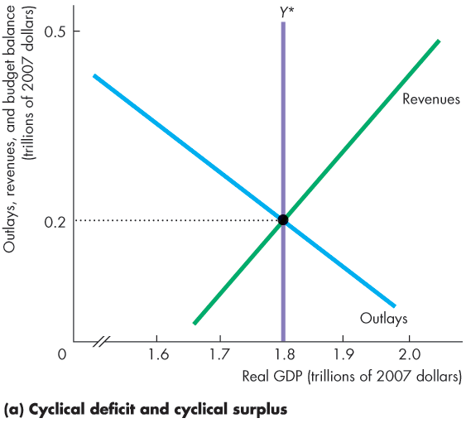
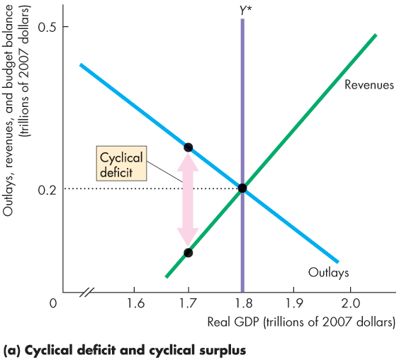
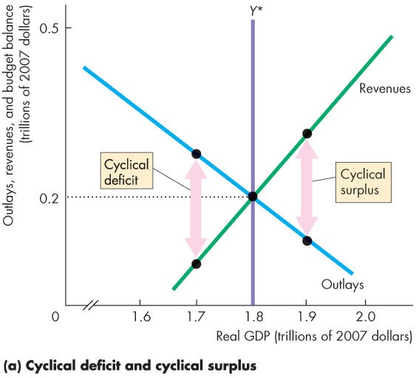
Fiscal Stimulus
Figure 13.8 illustrates the distinction between a structural and cyclical surplus and deficit.
In part (a), potential GDP is $1.8 trillion.
As real GDP fluctuates around potential GDP, a cyclical deficit or cyclical surplus arises.

Slide 37
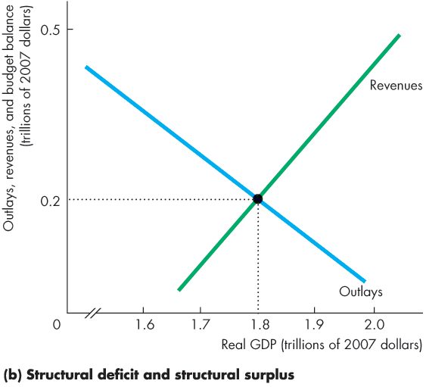
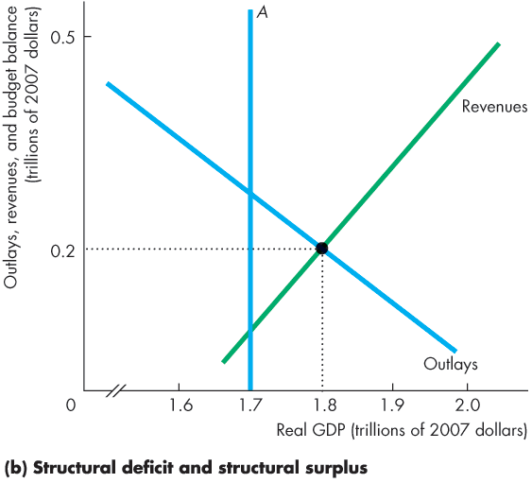
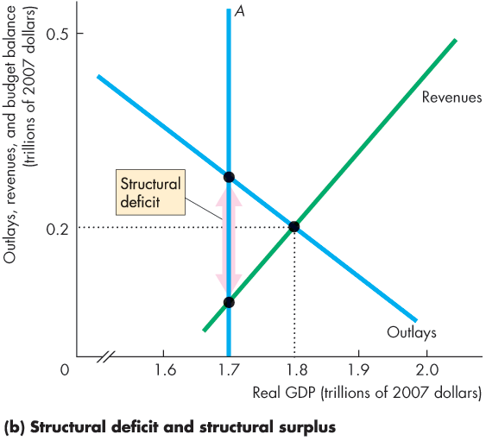
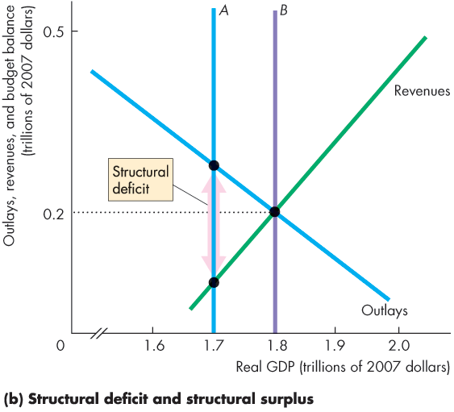
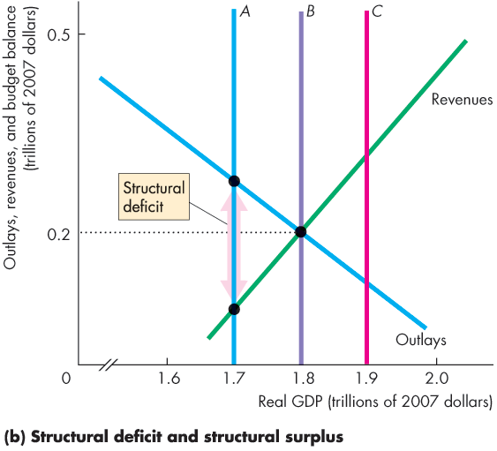
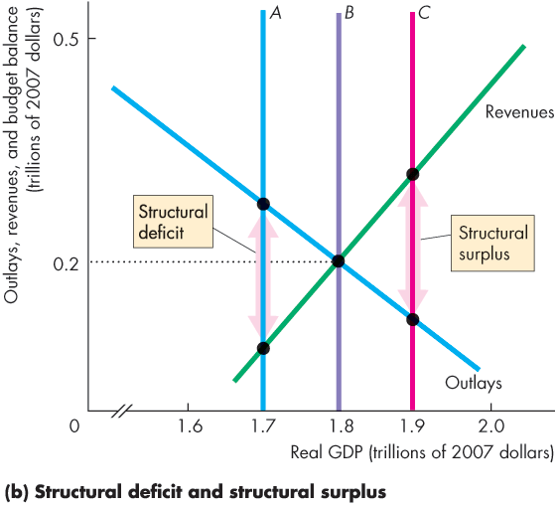
Fiscal Stimulus
In part (b), if real GDP and potential GDP are $1.7 trillion, the budget deficit is a structural deficit.
If real GDP and potential GDP are $1.8 trillion, the budget is balanced.
If real GDP and potential GDP are $1.9 trillion, the budget surplus is a structural surplus.

Slide 39
Fiscal Stimulus
Canadian Structural Budget Balance in 2016
The Canadian federal budget in 2016 was in deficit at $18 billion.
The Bank of Canada’s estimate of Canada’s recessionary gap was less than 1 percent of potential GDP, or about $13 billion. This recessionary gap is small.
With a small recessionary gap and a substantial budget deficit, most of the deficit was structural.
We don’t now exactly how much of the budget deficit was structural and how much was cyclical.
Notes:
Classroom activity
Check out Economics in Action: Canada’s 2016 Budget Deficit

Slide 40
Fiscal Stimulus
Discretionary Fiscal Stimulus
Most discretionary fiscal stimulus focuses on its effects on aggregate demand.
Fiscal Stimulus and Aggregate Demand
Changes in government expenditure and taxes change aggregate demand and have multiplier effects.
Two main fiscal multipliers are
Government expenditure multiplier
Tax multiplier
Notes:
Classroom activity
Check out Economics in Action: Fiscal Stimulus in the United States

Slide 41
Fiscal Stimulus
The government expenditure multiplier is the quantity effect of a change in government expenditure on real GDP.
Because government expenditure is a component of aggregate expenditure, an increase in government expenditure increases real GDP.
When real GDP increases, incomes rise and consumption expenditure increases. Aggregate demand increases.
If this were the only consequence of the increase in government expenditure, the multiplier would be >1.
Notes:
Classroom activity
Check out Economics in Action: How Big are the Fiscal Stimulus Multipliers?

Slide 42
Fiscal Stimulus
But an increase in government expenditure increases government borrowing and raises the real interest rate.
With the higher cost of borrowing, investment decreases, which partly offsets the increase in government expenditure.
If this were the only consequence of the increase in government expenditure, the multiplier would be < 1.
Which effect is stronger?
The consensus is that the crowding-out effect dominates and the multiplier is <1.

Slide 43
Fiscal Stimulus
The tax multiplier is the quantity effect a change in taxes on aggregate demand.
The demand-side effects of a tax cut are likely to be smaller than an equivalent increase in government expenditure.

Slide 44
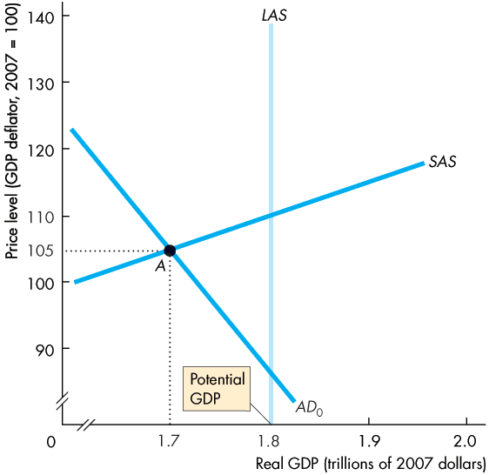
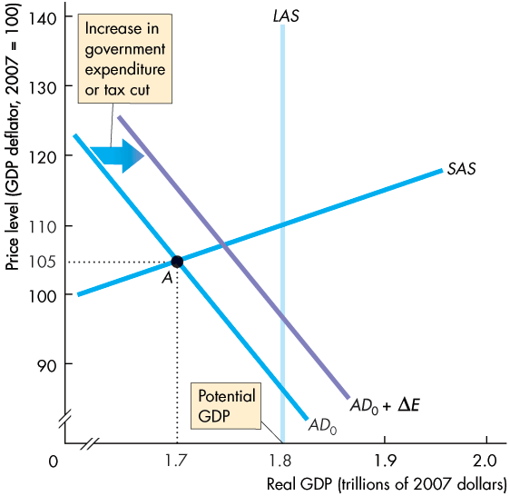


Fiscal Stimulus
Graphical Illustration of Fiscal Stimulus
Figure 13.9 shows how fiscal policy is supposed to work to close a recessionary gap.
An increase in government expenditure or a tax cut increases aggregate expenditure.
The multiplier process increases aggregate demand.

Slide 46
Fiscal Stimulus
Fiscal Stimulus and Aggregate Supply
Taxes drive a wedge between the cost of labour and the take-home pay and between the cost of borrowing and the return on lending.
Taxes decrease employment, saving, and investment and decrease real GDP and its growth rate.
A tax cut decreases these negative effects and increases real GDP and its growth rate.
The supply-side effects of a tax cut probably dominate the demand-side effects and make the multiplier larger than the government expenditure multiplier.
Notes:
Fiscal policy in practice. Most economists acknowledge that, in principle, discretionary fiscal policy can be used for stabilization purposes, but in practice such stabilization is extremely difficult because of long legislative lags. It is worth reminding the students that the equilibrium in the AS-AD model takes time to work out. The multiplier is a long drawn out process. An increase in government expenditures shifts the AD curve rightward but the new equilibrium price level and real GDP take time to occur. It is also useful to discuss the differences between the potential of fiscal policy under a parliamentary system and under the more rigid U.S. system; the length of time it took the congress to pass the 2002 ‘stimulus’ package, compared to almost immediate executive-initiated changes to fiscal policy in Britain, make the point that discretionary fiscal policy is feasible under some governmental systems but only in extreme circumstances in the world’s largest economy.
Classroom activity
Check out Economics in the News: Cutting the Corporate Tax Rate

Slide 47
Fiscal Stimulus
Time Lags
The use of discretionary fiscal policy is seriously hampered by three time lags:
Recognition lag—the time it takes to figure out that fiscal policy action is needed.
Law-making lag—the time it takes Parliament to pass the laws needed to change taxes or spending.
Impact lag—the time it takes from passing a tax or spending change to its effect on real GDP being felt.

